Slide 1
Lecture 3 – Pointers
Paula Hannan
hannanp@oit.edu
Last Changed: 1/23/2002

Slide 2
Objectives
Be able to:
Define and use pointer variables.
Use dynamic arrays.
Use pointer arithmetic.
Manage the memory associated with pointers including allocating and releasing memory.
Understand Static, Dynamic and Automatic Variables.

Slide 3
Hands-On
I've got several small experiments for you thoughout the class. They are marked with
Bring up a blank cpp file.
Separate each little experiment with {}. That way you don't have to worry if I've used the same variable names more than once.
  Why?
You may also want to bring up the slides so you can copy and paste.
Try-Me

Slide 4
Why Study Pointers
Pointers give YOU control of how memory is allocated.
  What advantages can you see to having control over memory allocation?
Pointers let you do "lazy" processes.... only allocate memory only when the user starts to use it.
We will study linked lists, one of the most common uses of pointers, in a couple of weeks.
Any other reasons to study pointers?

Slide 5
Pointer Intro
A pointer allows you to access memory directly.
It stores a memory address similar to how a URL stores the address of a web page.
Last term we talked about the fact that arrays were pointers. Now we will study the real deal.

Slide 6
Array Review
Lets Review Arrays a bit... turn to your book page 537.
The difference between arrays and pointers is that for arrays the compiler allocates the memory for you. With pointers you need to allocate memory.

Slide 7
Pointer Declaration
Declaration Syntax
  Pointers are declared using the * (splat) operator.
int * intPtr;
char * name;
The first declaration says: Give me place to store an address of an integer.
The second says: Give me a place to store the address of a character.

Slide 8
Pointers and &
Remember that the & is the address operator. So we can say:
int * intPtr;
int a;
intPtr = &a;
IntPtr is "Referring" to A

Slide 9
An Example
int *intPtr;
int apple=7;
intPtr = &apple;
Blah Blah
&apple = F55
7
Blah blah
IntPtr = ??
Blah Blah
&apple = F55
7
Blah Blah
IntPtr = F55

Slide 10
The Deference (*) operator
Now if I want to change the contents of apple I can say:
  int *intPtr, apple;
  intPtr = &apple;
  *intPtr = 5;
The dereferencing operator (*) allows you to access the values a pointer is pointing to.
Why have two names (IE *inPtr and apple) for the same thing?

Slide 11
Example Deference
What do you think will happen if I say?
  int *p, i=5;
  p = &i;
  cout << "P = " << p;
  cout << "*P = " << *p << endl;
Try it and see..
So p is what? *p is what?
Try-Me

Slide 12
Pointers and Functions
Say we have the following function prototype:
void foo(int * p);
What would the calling code look like:
int * purty;
foo( );
// How do you call foo for purty?

Slide 13
C Call by Reference
In C we do call by reference with pointers. i.e.
  void swap(int *a, int *b){
    int temp;
    temp = *a;
    *b = *a;
    *a = temp;
  }
and the call would be:
  int x=5, y=4;
  swap(&x,&y);

Slide 14
C Call by Reference Part 2
What is this really doing? Consider:
  void swap(int *a, int *b);
  int x=5, y=4;
  swap(&x,&y);
This is "call by value" on variables of type int *.
You can't change the address of the pointer, but you CAN change the values being pointed to.

Slide 15
C-String functions
Another example of passing pointers into function is c-string functions. For example the strcpy & strcat prototypes look something like:
void strcpy(char * target, char *source);
void strcat(char * target, char *source);
And we use it like:
  char blue[11] = "blue", bluegrass[11];
  strcpy(bluegrass,blue);
  strcat(bluegrass,"grass");

Slide 16
New Keyword
Frequently we use pointers because we don't know how big the data will be.
Use the new key word to allocate memory.
int *p = new int;
// gives me a place for the address
// and a space for the value at
// the same time.

Slide 17
Variable Types
Dynamic Variables: Variables created with new and destroyed with delete. Dynamic variables are stored in the heap (also called freestore).
Automatic Variables: The type of variables we have used so far. They are created automatically and destroyed automatically.
  Automatic variables are stored where?

Slide 18
Delete
If you use a new statement then you need to be careful that you do a corresponding delete.
A delete removes the memory allocated by the new.
If you get a heap error, you've got a memory allocation problem.
Lets all turn to page 684 – Display 11.2 – What's wrong with this program?

Slide 19
P Vs *P
If I use the declaration:
int *p = new int;
Then to use the memory I've just allocated I have to dereference. Which is correct a or b?
a) p = 5;
b) *p = 5;

Slide 20
The Null Pointer
C++ has a special pointer NULL.
You can assign it to any pointer to basically zero it.
Refer to Page 688 at your leisure.

Slide 21
The Null Pointer
Frequently you'll see code like:
  int * p = NULL;
  if (p) //
    cout << "Addr of p\t" << p << endl;
  else
    cout << "P is Null" << endl;
How does this if statement work?
Try this code. Then see what happens if you take NULL off the initialization
Try-Me

Slide 22
* operator Review
The * operator is used in two ways.
  In a definition a * means this variable is a pointer.
  In other statements a * means "access" the data pointed to by the pointer.
int *p; // p is a pointer variable
int x = 7, i;
p = &x; // p points to the value in x
i = *p; // i = the value pointed at by p;
// so what is i anyway?

Slide 23
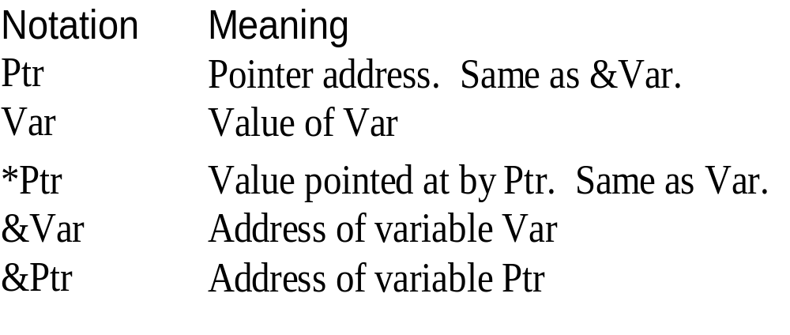
Quick Summary
  int Var, *Ptr;
  Ptr = &Var;

Slide 24
Pointer Usage
What would happen if you:
int *p = new int;
*p = 5;
delete p;
cout << "P " << p <<"*p " << *p;
Try it and see..
Try-Me

Slide 25
Other Memory boo-boo's
How about this:
int *p = new int, *k;
*p=5;
k=p;
delete p;
cout << *k;
What is k now?
  Its 404 k not found...
Try-Me

Slide 26
Arrays as pointers
Arrays are basically specialized pointers. Try the following code:
  int p[5];
  cout << "Addr of p[0]\t" << p << endl;
  cout << " or\t\t" << &p[1] << endl;
What does the &p[1] do?
Try-Me

Slide 27
Arrays as pointers
Here is a different Example
  int pali[11];
  printf("The addr of pali is %x\n",pali);
  cout << endl << pali << endl;
cout is smart with cstrings. It assumes you want the string not the address. Remember we printed the address before with:
  int p[5];
  cout << "Addr of p[0]\t" << p << endl;
printf is how you print in C

Slide 28
Pointer Arithmetic
You can use + or – with pointers and integers.
We've seen it for arrays and most frequently with character arrays.
It does what you think. Add some pointer arithmetic to your last demo
int *p new int[5];
cout << "Addr of p[0]\t" << p << endl;
cout << " or\t\t" << &p[1] << endl;
cout << "Addr of p[1]\t" << p+1 << endl;
Try-Me

Slide 29
Pointer Arithmetic
What would the following mean?
  int x = 10, y = 20, ;
  int * px = &x;
  x++;
  x--;
  px++;

Slide 30
Pointer Arithmetic
What would the following mean?
  int x = 10, y = 20;
  int * px = &x;
  *px++; // op precedence is on page 913
Is this (*px)++ or *(px++)?

Slide 31
Pointers and Arrays Example
We're going to do a hands on similar to:
  char pali[11] = "radar";
  char *beg, *end;
  beg = pali;
  end = beg + ?? ;
  r a d a r \0
end
pali
beg

Slide 32
Pointers and Arrays Example
There are two functions:
  void loopCheckPalindrome(char p[]);
  void pointerCheckPalindrome (char * p);
How would you call them for:
char pali[11] = "radar";

Slide 33
Palindrome Hands On
Open palindrome.cpp

Slide 34
Typdef
Typedef helps make your program more readable and reliable.
Syntax:
  typedef c++_type type_name;
For example
  typedef double money;
  typedef *int integer_pointer;

Slide 35
More Typdef
For example
  typedef double money;
  typedef *int integer_pointer;
Then you say:
  money sales,expenses;
  integer_pointer p;

Slide 36
Typedef Advantages
How does this improve reliability?
How does typedef improve readability?

Slide 37
Typedef Advantages
How does this improve reliability?
  Typedef is used to eliminate conceptually confusing syntax.
  Reduces people choosing different c++ types for the same conceptual type.
How does typedef improve readability?
  Provides context for variables.

Slide 38
Dynamic Arrays
Remember how we said an array was really a pointer. C++ takes advantage of this and allows you to dynamically size arrays. (Note: This is NOT C)
We also said that you had to size an array big enough for the biggest possible data... a definite drag.

Slide 39
Dynamic Arrays
Syntax:
pointer_variable = new type[size];
delete [] pointer_variable;
IE
int *peace,size=5;
peace = new int[size];
peace[3] = 3;
delete [] peace;

Slide 40
New Gotcha
What do you think would happen if we did:
int *peace,size=5;
peace = new int[size];
cout << peace[3];
delete [] peace;
Try it and see.
Try-Me

Slide 41
More Dynamic Arrays
Page 695 has the steps for using dynamic arrays. They are:
  (optional) define a pointer type.
  Declare a pointer variable.
  Create space by calling new.
  Use like an ordinary array
  Call delete.

Slide 42
Dynamic Array Design Questions
When do chose a dynamic array?
When do you chose to use a fixed size array?

Slide 43
Dynamic Array Design Questions
When do chose a dynamic array?
  The array is of variable size and its relatively big.
When do you chose to use a fixed size array?
  The array is small
  The possible size difference between the smallest array and the biggest array is relatively small.

Slide 44
Another example
int *i_mytab, c_mytab;
// get a count of the number of records using
// an SQL statement. (Ignore the SQL syntax)
select count * into c_mytab from mytab
where foo = 'Y';
// allocate only enough memory based on c_mytab
*i_mytab = new int[c_mytab] ;

Slide 45
More New
What does the new statement do to the pointer? Try this:
  double * temp;
  cout << "ST Addr temp is " << temp << endl;
  temp = new double[5];
  cout << "NW Addr temp is " << temp << endl;
  delete [] temp;
  cout << "DL Addr temp is " << temp << endl;
Try-Me

Slide 46
Pointers and New
There are two morals to this story.
1. Its probably safer to set the pointer to NULL after the delete
2. You need to be careful passing dynamic arrays into functions. In the following example is the pointer itself pass by value or pass by reference?
  void loadArray(double * Arr);

Slide 47
Pointers and New
Remember that the pass by reference syntax is:
  function_name (type & var_name);
For a pointer to double the type is "double *"
SO, to allow the pointer itself to change you have to pass it by reference. IE
    void fillArray(double * & Arr);
To call this function it would be:
  double * myArray;
  fillArray(myArray);

Slide 48
Hands On
You are a programmer at Ace Gidgets.
They are growing exponentially and realize that their salary raise program isn't coded effectively. Each time they gain new employees they have to modify the program to enlarge the size of the array.
Instead they should be using a dynamic array.
Luckily someone has started the work for you.

Slide 49
Hands On
Giving Raises – raise.cpp
  This program reads a file of salary's. The first line in the file is the number of salary's in the file.
First read through the program and student tasks and then just do it.
A sample file is in raise.txt

Slide 50
Static Variables Vs Global Variables
C uses the keyword static with global variables to prevent visibility from within other files.
Be careful in C++ with this use of static. It is going away.
C++ uses unnamed namespaces to make names invisible outside a file.

Slide 51
Malloc and Free
In C we use malloc and free for new and delete:
  Syntax: x = (cast) malloc (size);
  To make this compiler independent it's:
    x = (cast) malloc(sizeof(element));
  Syntax of free is: free(x);
Malloc and free have the same memory management issues as new and delete
In this class use NEW and DELETE but be able to read and explain malloc and free.

Slide 52
Calloc
C has two other allocation routines. Calloc & ralloc:
Calloc takes the number of elements and the size of element. It multiplies number and size to determine how much memory to allocate. Calloc also initializes all its elements to 0. Here is the prototype.
void * calloc (size_t nelements, size_t size);
Notice the use of the typedef size_t in this prototype.

Slide 53
realloc
Realloc changes the size of a block of memory already assigned to a pointer.
  void * realloc (void * pointer, size_t size);
Notice how the first parameter is a pointer to void. Any pointer can be assigned to a pointer of type void.

Slide 54
Have we met the objectives?
Can you:
Define and use pointer variables.
Use dynamic arrays.
Use pointer arithmetic.
Manage the memory associated with pointers including allocating and releasing memory.
Understand Static, Dynamic and Automatic Variables.

Slide 55
Home Study
Be able to answer all self test exercises in Chapter 11.1 & 11.2
Be able to define or understand the issue highlighted for terms in Chapter 11.1 & 11.2
Read Chapter 12

Slide 56
Today's Index card
For 5 points:
  Front => Three important points from this class
  Back =>
    One thing you think I should review next time.

